Slide 1
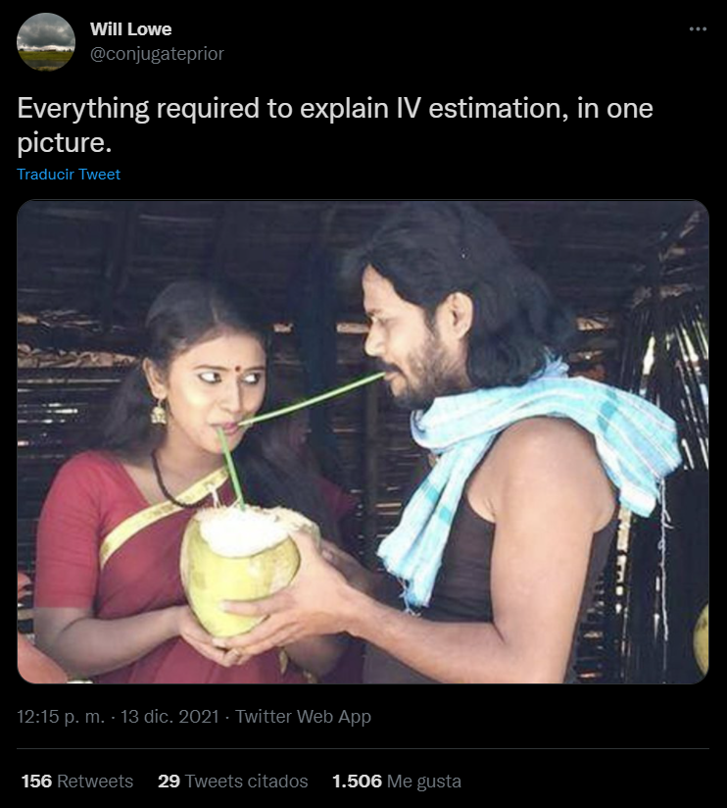
INSTRUMENTAL VARIABLES
José Manuel Arencibia Alemán & Isa Steinmann
Session 7

Slide 2
5 | Regression Models Time: 31 January 2022, 12:15 – 14:00h Main Instructor: Isa Steinmann Required Reading: Angrist & Pischke (2015), Chapter 2
6 | Further Control Strategies Time: 03 February 2022, 12:15 – 14:00h Main Instructor: Isa Steinmann Required Reading: -
7 | Instrumental Variable Approaches Time: 07 February 2022, 12:15 – 14:00h Main Instructor: José Manuel Arencibia Alemán Required Reading: Angrist & Pischke (2015), Chapter 3
8 | Regression Discontinuity Designs I Time: 10 February 2022, 12:15 – 14:00h Main Instructor: José Manuel Arencibia Alemán Required Reading: Angrist & Pischke (2015), Chapter 4

Slide 3

Last session’s take-away messages
Matching methods can be useful complementation of regression methods but they do not solve omitted variable bias
Pretest variables are usually very valuable control variables
Fixed-effects can be valuable additions to control strategies

Slide 4
Session’s learning goal
Understand the intuition behind instrumental variables approach, its potential and its limitations

Slide 5

Content
Introduction
Instrument Variables vs. Control Strategies
The Charter Conundrum
IV requirements
LATE (vs. TOT)
Family Size and Parental Investments in Children
2SLS
R Example
Photo by Taneli Lahtinen on Unsplash

Slide 6

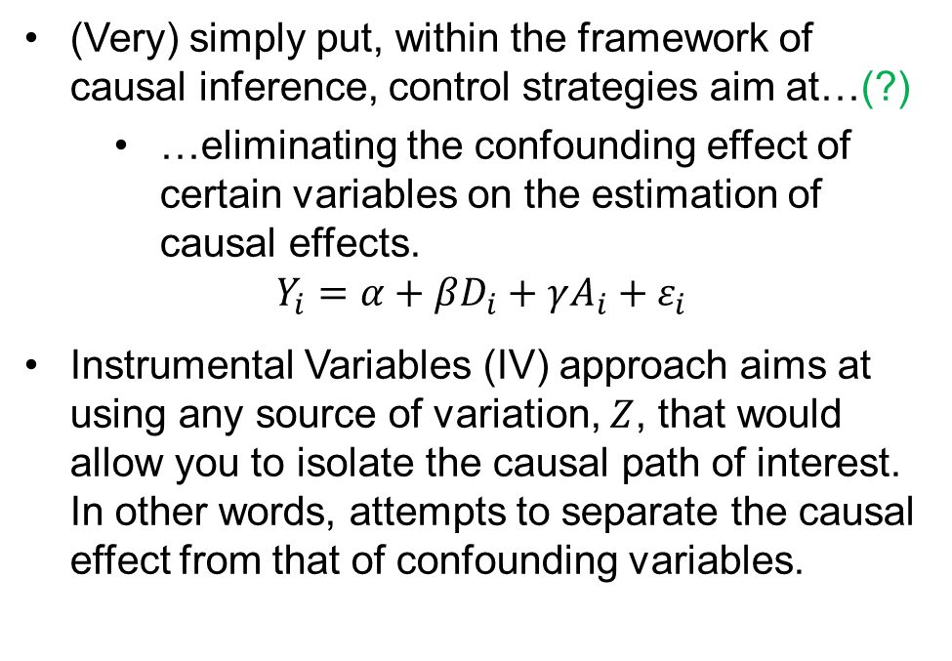





Instrumental Variables vs. Control Strategies
$$A$$
(Very) simply put, within the framework of causal inference, control strategies aim at…(?)
…eliminating the confounding effect of certain variables on the estimation of causal effects.
$$Y_{i}=α+βD_{i}+γA_{i}+ε_{i}$$
Instrumental Variables (IV) approach aims at using any source of variation, $Z$, that would allow you to isolate the causal path of interest. In other words, attempts to separate the causal effect from that of confounding variables.
$$Z$$
$$D$$
$$Y$$
$$U$$
$$A_{i}$$
“The instrumental variables (IV) method harnesses partial or incomplete random assignment, whether naturally occurring or generated by researchers.” (Angrist and Pischke 2015, p. 98)
Notes:
0. If we simplify (very much) what we learnt on sessions 5 and 6 we have that control strategies…
DAG causal relation we want to measure
Som observable (vector) of variables confound the relation
Including it in the regression eliminate bias on the variable
But what if there are other unobserved variables that have the same effect than A but are not observed? A back door that confounds the estimate of causal effect even if we control for A?
Instrumental variables role (emphasis isolating causal effect taking advantage of a source of partial random assignment)
If we find an instrument Z, that causes X but is uncorrelated with U and Y, we can close any back door through which the causal effect of X on Y is being confounded. THAT is the ituition of IV approach
Definition from the book

Slide 7
The Charter Conundrum
Setting the Stage
Application and enrollment data from KIPP Lynn lotteries (Angrist and Pischke, 2015, p. 103)
Knowledge Is Power Program (KIPP):
140 charter schools affiliated
Emphasis on discipline, long-school days, focus on math and reading skills
Higher average scores than nearby schools
Teachers: recent graduates of America’s most selective colleges and universities
Students and context:
Low-performing school districts. 95% ethnic minorities.
>80% poor enough to qualify for the federal government’s subsidized lunch program
Lotteried first-time applicants to KIPP (466)
Offered a seat (303)
Not offered a seat (143)
73% (221) attend KIPP
3,5% (5) attend KIPP
Angrist and Pischke (2015)
Notes:
0. We are going to use this example from the book to illustrate how IV works. Description of the set up
KIPP skeptics have argued that KIPP’s apparent success reflects the fact that KIPP attracts families whose children are more likely to succeed anyway.
Representation of the set-up. Notice that lottery is partial or incomplete source of random assignment. Some of the randomness is lost because not everyone who won the lottery (221/303) goes to KIPP, while some who did not won the lottery (5/143) manages to get into KIPP

Slide 8
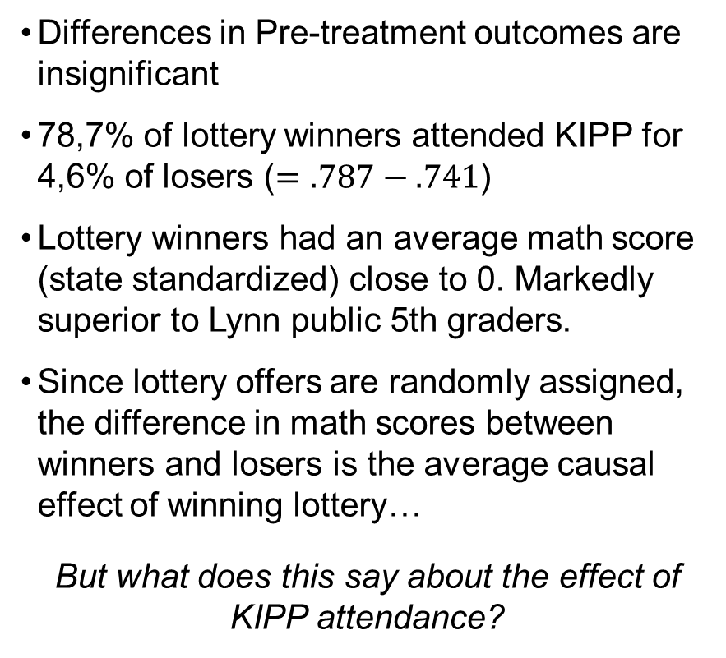
The Charter Conundrum
Analysis of KIPP lotteries (Angrist and Pischke, 2015, p. 104)
Playing the Lottery
Differences in Pre-treatment outcomes are insignificant
78,7% of lottery winners attended KIPP for 4,6% of losers ($=.787−.741$)
Lottery winners had an average math score (state standardized) close to 0. Markedly superior to Lynn public 5th graders.
Since lottery offers are randomly assigned, the difference in math scores between winners and losers is the average causal effect of winning lottery…
But what does this say about the effect of KIPP attendance?
 |  |  | KIPP applicants
 | Lynn public 5th graders |  | Lottery winners | Winners vs. losers | Attended KIPP | Attended vs. others
Panel A. (Selected) Baseline Characteristics
Math score (4th grade) |  | -.307 | -.290 | .102 (.120) | -.289 | 0.69 (.109)
Verbal score (4th grade) |  | -.356 | -.386 | .0.63 (.125) | -.368 | .088 (.114)
Panel B. Outcomes
Attended KIPP |  | .000 | .787 | .741 (.037) | 1 | 1
Math score |  | -.363 | -.003 | .355 (.115) | .095 | .467 (.103)
Verbal score |  | -.417 | -.262 | .113 (.122) | -.211 | .211
Sample size |  | 3,964 | 253 | 371 | 204 | 371
Angrist and Pischke (2015)
Notes:
Notice that there are no significant differences between those who attended KIPP in pre-treatment outcomes. Already a sign that skeptics might be wrong in doubting the effectiveness of KIPP but not enough.
The lottery system is a source of partial randomness
Lottery winners (this includes also those who won the lottery but did not attend KIPP) have a markedly superior outcome (close to state average, when the rest of Lynn is 3 standards deviations under the statal average
«causal effect» of the lottery
But this does not say anything about the effect of attending to KIPP. The difference in scores of those who attended migh be contaminated by the potential selection issues that make skeptiks doubt the effect of KIPP

Slide 9
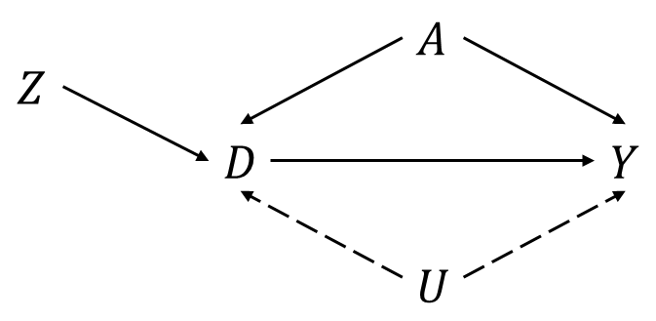
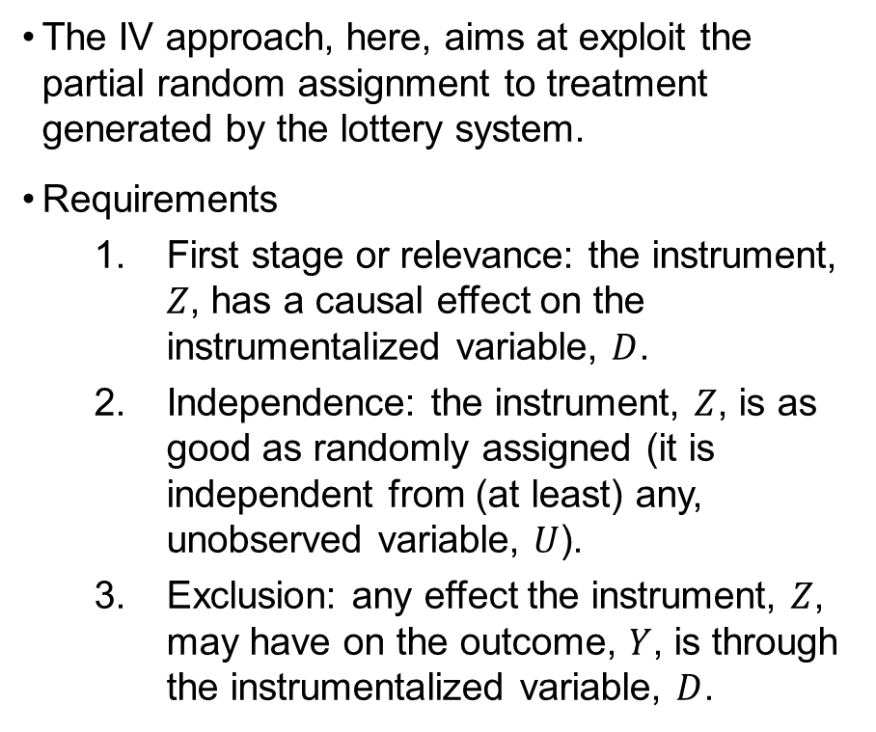
The Charter Conundrum
Analysis of KIPP lotteries (Angrist and Pischke, 2015, p. 104)
Instrumental Variables
The IV approach, here, aims at exploit the partial random assignment to treatment generated by the lottery system.
Requirements
First stage or relevance: the instrument, $Z$, has a causal effect on the instrumentalized variable, $D$.
Independence: the instrument, $Z$, is as good as randomly assigned (it is independent from (at least) any, unobserved variable, $U$).
Exclusion: any effect the instrument, $Z$, may have on the outcome, $Y$, is through the instrumentalized variable, $D$.
 |  |  | KIPP applicants
 | Lynn public 5th graders |  | Lottery winners | Winners vs. losers | Attended KIPP | Attended vs. others
Panel A. (Selected) Baseline Characteristics
Math score (4th grade) |  | -.307 | -.290 | .102 (.120) | -.289 | 0.69 (.109)
Verbal score (4th grade) |  | -.356 | -.386 | .0.63 (.125) | -.368 | .088 (.114)
Panel B. Outcomes
Attended KIPP |  | .000 | .787 | .741 (.037) | 1 | 1
Math score |  | -.363 | -.003 | .355 (.115) | .095 | .467 (.103)
Verbal score |  | -.417 | -.262 | .113 (.122) | -.211 | .211
Sample size |  | 3,964 | 253 | 371 | 204 | 371
Angrist and Pischke (2015)
Notes:
But for the lottery system to be able to «isolate» the causal effect of attendance, must satisfy three conditions
Ask if this is reasonable, pin-point the difference in attendance between winners and losers .741
Ask if this is reasonable, pin-point that the lottery, in principle, is assumed to be random (nobody tampering with it) and so independent of unobservable differences
At least: ideally independent of all variables, observed and unobserved… but if is correlated with observed variables, we can use the traditional «control strategies» already seen.
Ask if this is reasonable. Might winning the lottery suddenly motivate more the winners? Possibly but unlikely. Exclusion is generally difficult to prove. FIRST PROBLEM with IV. Relies on this assumption which can hardly be proved.

Slide 10

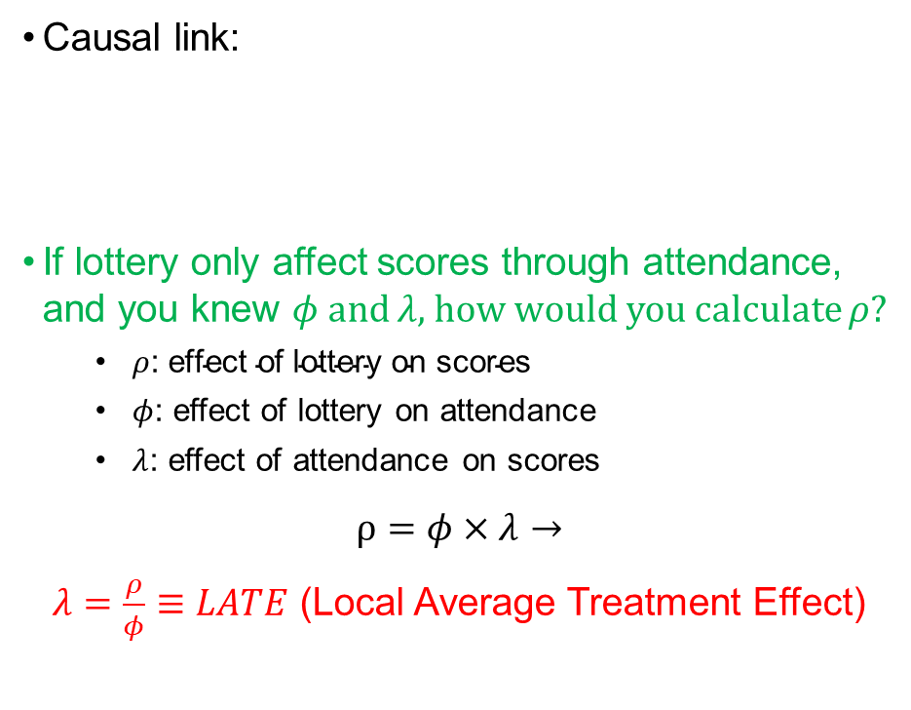



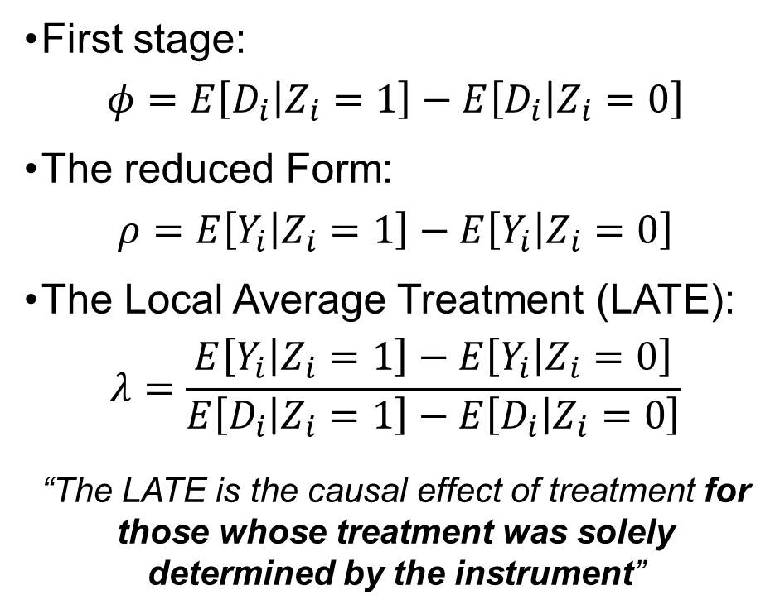
The Charter Conundrum
Instrumental Variables
Causal link:
If lottery only affect scores through attendance, and you knew $φ$ and $λ$, how would you calculate $ρ$?
$ρ\text{: }\text{effect} \text{of} \text{lottery} \text{on} \text{scores}$
$φ$: effect of lottery on attendance
$λ$: effect of attendance on scores
$$ρ=φ×λ→$$
$λ=\frac{ρ}{φ}≡LATE$ (Local Average Treatment Effect)
First stage:
$$φ=E\left[D_{i} | Z_{i}=1\right]−E\left[D_{i} | Z_{i}=0\right]$$
The reduced Form:
$$ρ=E\left[Y_{i} | Z_{i}=1\right]−E\left[Y_{i} | Z_{i}=0\right]$$
The Local Average Treatment (LATE):
$$λ=\frac{E\left[Y_{i} | Z_{i}=1\right]−E\left[Y_{i} | Z_{i}=0\right]}{E\left[D_{i} | Z_{i}=1\right]−E\left[D_{i} | Z_{i}=0\right]}$$
“The LATE is the causal effect of treatment for those whose treatment was solely determined by the instrument”
$$Lottery$$
$$Attendance$$
$$Scores$$
$$Parents$$
Notes:
We are interested on the association of attendance to scores
However , skeptiks argue than unobservable variables, such as parents attitudes, might influence that relation, thus biasing
On the other hand, if we accept that the lotteriy is a good intrument (satisfy the three requirements) we can use it to isolate the causal effect of attendance that is, that they are relevant to attendance (first stage or independence), independent (randomly assigned) and, we have assumed, satisfy the exclusion requirement (any effect on scores is through attendance or, in other words, is not correlated with parents attitudes or any other observable characteristic)
Relevance is this
An thus, through attendance to KIPP will affect scores.
This is called reduced form
EXERCISE
The effect of lottery on attendance (first stage) x the effect of attendance (due to have won the lottery, no other, e.g., parents) on scores. Formally = rho = phi x lambda
THIS ALLOWS US TO IDENTIFY THE EFFECT OF ATTENDANCE ON SCORES THAT IS SOLELY DUE TO WINNING THE LOTTERY (LATE)

Slide 11
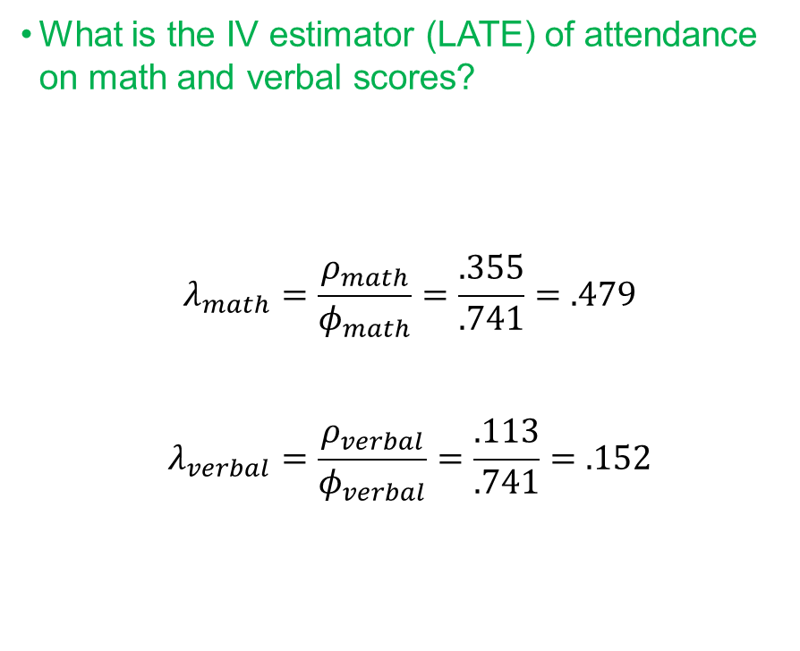
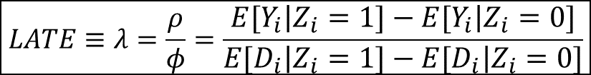
The Charter Conundrum
Analysis of KIPP lotteries (Angrist and Pischke, 2015, p. 104)
Instrumental Variables
What is the IV estimator (LATE) of attendance on math and verbal scores?
$$λ_{math}=\frac{ρ_{math}}{φ_{math}}=\frac{.355}{.741}=.479$$
$$λ_{verbal}=\frac{ρ_{verbal}}{φ_{verbal}}=\frac{.113}{.741}=.152$$
 |  |  | KIPP applicants
 | Lynn public 5th graders |  | Lottery winners | Winners vs. losers | Attended KIPP | Attended vs. others
Panel A. (Selected) Baseline Characteristics
Math score (4th grade) |  | -.307 | -.290 | .102 (.120) | -.289 | 0.69 (.109)
Verbal score (4th grade) |  | -.356 | -.386 | .0.63 (.125) | -.368 | .088 (.114)
Panel B. Outcomes
Attended KIPP |  | .000 | .787 | .741 (.037) | 1 | 1
Math score |  | -.363 | -.003 | .355 (.115) | .095 | .467 (.103)
Verbal score |  | -.417 | -.262 | .113 (.122) | -.211 | .211
Sample size |  | 3,964 | 253 | 371 | 204 | 371
$$LATE≡λ=\frac{ρ}{φ}=\frac{E\left[Y_{i} | Z_{i}=1\right]−E\left[Y_{i} | Z_{i}=0\right]}{E\left[D_{i} | Z_{i}=1\right]−E\left[D_{i} | Z_{i}=0\right]}$$
Angrist and Pischke (2015)
Notes:
EXERCISE

Slide 12
WARNING
“Because the treated population includes always-takers [in our example, those who found a way to be treated even though they did not win the lottery (5/226=.022 of KIPP attendants)], LATE and TOT [Treatment-On-the-Treated, in our example, all attendants] are usually not the same.” (Angrist and Pischke 2015, p. 114).
External Validity?
Depends on the validity of our assumptions
Can be tested if we find more than one instrument (that would affect different segments of the population).
If that was the case, and estimates were equal, we would have evidences to argue for the external validity of LATE, i.e., that it approaches to TOT.
“With no always-takers, all of the treated are compliers, in which case, LATE is TOT.” (Angrist and Pischke 2015, p. 121)
Notes:
Validity of assumptions: relevance, indepence and exclusion
Different sets of compliers with same LATE -> suggest that LATE might be TOT
(up)
Always-takers: students that will go to KIPP independently of the results in the lottery (people who would find a way to get in even if they do not win the lottery).

Slide 13





Family Size and Parental Investments in Children
Setting the Stage
$$Mother Ed.$$
There is a negative correlation between family size and development indicators such as schooling
Hypothesis (Becker et al.1973, 1976): quantity-quality trade-off; as family size increases parental investment in children decreases
Is there a causal connection between family size and children’s education?
Mother’s education
But also: children characteristics (health problems), family structure, gender, home environment, occupation
$$Family Size$$
$$Schooling$$
$$U$$
“The instrumental variables (IV) method harnesses partial or incomplete random assignment, whether naturally occurring or generated by researchers.” (Angrist and Pischke 2015, p. 98)
Notes:
0. We use the last example in the book to illustrate a more sophisticated and sound way to obtain LATE estimates. In this example…
A common hypothesis is…
But there might be several reasons for which family size is endogenous
For example we know that educated mothers tend to have fewer children, and that parental SES is highly correlated with academic achievement of children
But there may be other variables, some of them unobservable, that we can not control for
Here comes the magic of IV

Slide 14




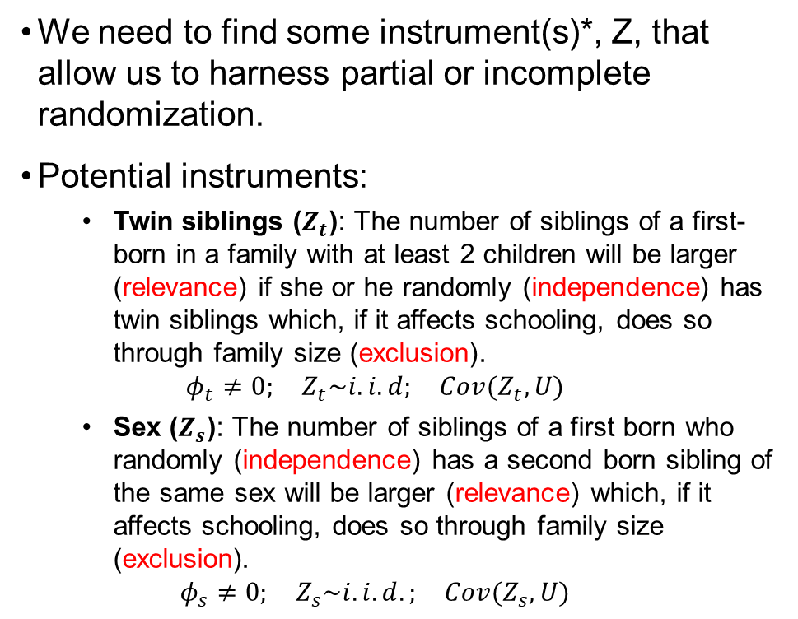


Family Size and Parental Investments in Children
Setting the Stage II
We need to find some instrument(s)*, Z, that allow us to harness partial or incomplete randomization.
Potential instruments:
Twin siblings ($Z_{t}$): The number of siblings of a first-born in a family with at least 2 children will be larger (relevance) if she or he randomly (independence) has twin siblings which, if it affects schooling, does so through family size (exclusion).
$$φ_{t}≠0; Z_{t}\sim i.i.d; Cov(Z_{t}, U)$$
Sex ($Z_{s}$): The number of siblings of a first born who randomly (independence) has a second born sibling of the same sex will be larger (relevance) which, if it affects schooling, does so through family size (exclusion).
$$φ_{s}≠0; Z_{s}\sim i.i.d.; Cov(Z_{s}, U)$$
$$Mother Ed.$$
$$Z$$
$$Family Size$$
$$Schooling$$
$$U$$
(*) slide 12
Angrist and Pischke (2015)
Notes:
Potential instruments requirements
relevance (first stage) requirement.
We further need independence (having twins does not depend of the parents –e.g., nowadays age is a factor-, and sex of the second child does not depend of the parents),
and the exclusion restriction (the only way this affect schooling of the population is through their effect on family size -e.g., we might think that sex composition of the children might influence allocation of educational investment across children within families, or whether or not they share bedroom, leisure, educational space).
If requirements are satisfied we can move from fruitless to fruitful comparisons, aka, estimation of LATEs

Slide 15
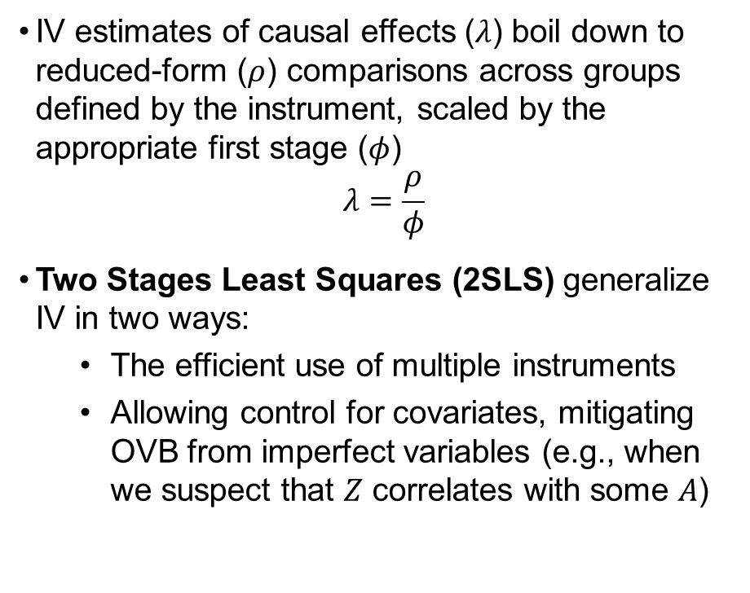
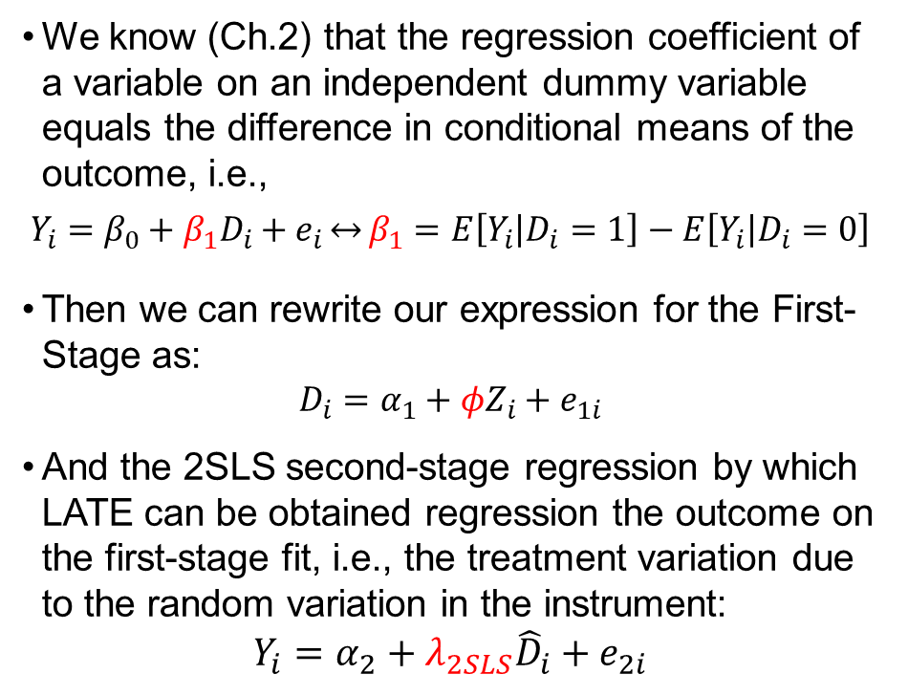
Family Size and Parental Investments in Children
Treatment
Outcome
Two Stages Least Squares (2SLS)
How to 2SLS
IV estimates of causal effects ($λ$) boil down to reduced-form ($ρ$) comparisons across groups defined by the instrument, scaled by the appropriate first stage ($φ$)
$$λ=\frac{ρ}{φ}$$
Two Stages Least Squares (2SLS) generalize IV in two ways:
The efficient use of multiple instruments
Allowing control for covariates, mitigating OVB from imperfect variables (e.g., when we suspect that $Z$ correlates with some $A$)
We know (Ch.2) that the regression coefficient of a variable on an independent dummy variable equals the difference in conditional means of the outcome, i.e.,
$$Y_{i}=β_{0}+β_{1}D_{i}+e_{i}\overset{↔}{}β_{1}=E\left[Y_{i} | D_{i}=1\right]−E\left[Y_{i} | D_{i}=0\right]$$
Then we can rewrite our expression for the First-Stage as:
$$D_{i}=α_{1}+φZ_{i}+e_{1i}$$
And the 2SLS second-stage regression by which LATE can be obtained regression the outcome on the first-stage fit, i.e., the treatment variation due to the random variation in the instrument:
$$Y_{i}=α_{2}+λ_{2SLS}{\hat{D}}_{i}+e_{2i}$$
Instrument
Angrist and Pischke (2015)
Notes:
Recapitulating
Why do we want to do 2SLS
How do we estimate them.
Re-writing first stages
The predicted treatment is a prediction of treament due only to the random assignment process occurring in the first stage
In other words, with the instrument, we strip from the treatment all the variation that is not random (linked to other variables, included unobservable) to obtain an estimate of the LATE

Slide 16
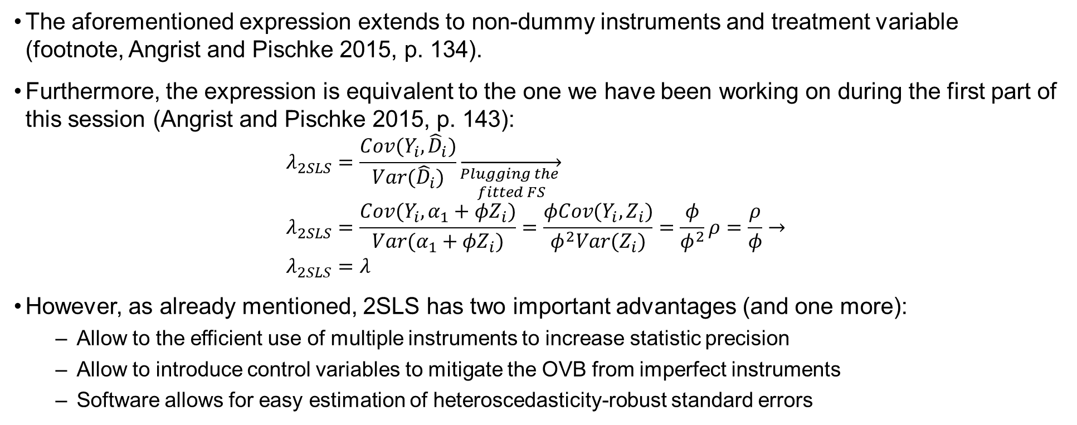
Family Size and Parental Investments in Children
How to 2SLS
The aforementioned expression extends to non-dummy instruments and treatment variable (footnote, Angrist and Pischke 2015, p. 134).
Furthermore, the expression is equivalent to the one we have been working on during the first part of this session (Angrist and Pischke 2015, p. 143):
$$λ_{2SLS}=\frac{Cov(Y_{i},{\hat{D}}_{i})}{Var({\hat{D}}_{i})}\overset{→}{\begin{aligned}Plugging the \\ fitted FS\end{aligned}} \\ λ_{2SLS}=\frac{Cov(Y_{i},α_{1}+φZ_{i})}{Var(α_{1}+φZ_{i})}=\frac{φCov(Y_{i},Z_{i})}{φ^{2}Var(Z_{i})}=\frac{φ}{φ^{2}}ρ=\frac{ρ}{φ}→ \\ λ_{2SLS}=λ$$
However, as already mentioned, 2SLS has two important advantages (and one more):
Allow to the efficient use of multiple instruments to increase statistic precision
Allow to introduce control variables to mitigate the OVB from imperfect instruments
Software allows for easy estimation of heteroscedasticity-robust standard errors
Notes:
2. Despite the equality of the coefficients, 2SLS has several advantages

Slide 17
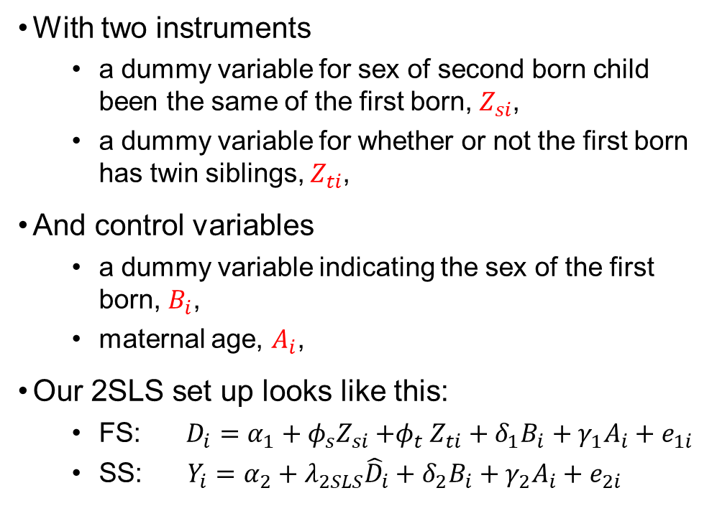
Family Size and Parental Investments in Children
How to 2SLS
With two instruments
a dummy variable for sex of second born child been the same of the first born, $Z_{si}$,
a dummy variable for whether or not the first born has twin siblings, $Z_{ti}$,
And control variables
a dummy variable indicating the sex of the first born, $B_{i}$,
maternal age, $A_{i}$,
Our 2SLS set up looks like this:
FS: $D_{i}=α_{1}+φ_{s}Z_{si}{+φ}_{t}Z_{ti}+δ_{1}B_{i}+γ_{1}A_{i}+e_{1i}$
SS: $Y_{i}=α_{2}+λ_{2SLS}{\hat{D}}_{i}+δ_{2}B_{i}+γ_{2}A_{i}+e_{2i}$
OLS and 2SLS estimates of the quantity-quality trade off (Angrist and Pischke, 2015, p. 137)
 |  | 2SLS estimates
Dependent variable | OLS estimates | Twins estimates | Same-sex estimates | Twins and same-sex estimates
Years of Schooling | -.145 (.005) | .174 (.166) | .318 (.210) | .237 (.128)
Notice that, as predicted, IV estimates have higher standard errors but, when combining both, statistical precision increases (standard errors fall).
Notes:
1. Also, notice that the LATE for both examples is different, which threatens the external validity. The increase in precision does not only increases precision of the estimate, but also yields a LATE informed by two different sources of randomization-> more external validity.

Slide 18
WARNING
“A researcher blessed with many instruments knows that some produce a stronger first stage than others. The temptation is to use them all anyway […]. The risk here is that 2SLS estimates with many weak instruments can be misleading. A weak instrument is one that isn’t highly correlated with the repressor being instrumented, so the first-stage coefficient associated with this instrument is small or imprecisely estimated.” (Angrist and Pischke 2015, p. 114).

Slide 19
R example
“iv_example.pdf”

Slide 20

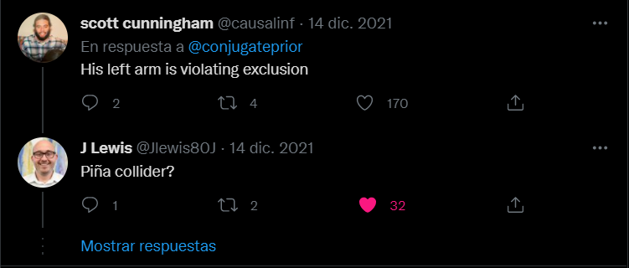
Piña collider?

Slide 21
Take away messages
IV allow us to draw causal inferences when treatment is endogenous
Good instruments (relevant, independent and satisfying the exclusion restriction) are hard to find.
External validity of LATEs should be well argued for, specially if instruments are “naturally occurring”.

Slide 22
5 | Regression Models Time: 31 January 2022, 12:15 – 14:00h Main Instructor: Isa Steinmann Required Reading: Angrist & Pischke (2015), Chapter 2
6 | Further Control Strategies Time: 03 February 2022, 12:15 – 14:00h Main Instructor: Isa Steinmann Required Reading: -
7 | Instrumental Variable Approaches Time: 07 February 2022, 12:15 – 14:00h Main Instructor: José Manuel Arencibia Alemán Required Reading: Angrist & Pischke (2015), Chapter 3
8 | Regression Discontinuity Designs I Time: 10 February 2022, 12:15 – 14:00h Main Instructor: José Manuel Arencibia Alemán Required Reading: Angrist & Pischke (2015), Chapter 4

Slide 23
Recommended Literature
Cunningham, S. (2021). Causal inference : the mixtape. New Haven, Connecticut, Yale University Press. (Chapter 5)
N. Huntington-Klein (2022). The effect : an introduction to research design and causality. Boca Raton, Chapman and Hall/CRC Press. (Chapter 19)

Slide 24
References
Angrist, J. D. and J.-S. Pischke (2015). Mastering 'metrics : the path from cause to effect. Princeton, N.J, Princeton University Press.

